Slide 1

STUDENT ACADEMIC CALENDAR
A Project by –
Snehith Kumar
Siddhi Vinayak
Sriram Reddy

Slide 2
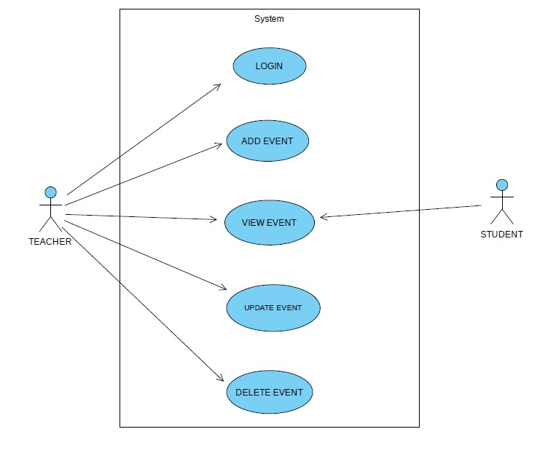
USE CASE DIAGRAM

Slide 3
Actors wise use cases
STUDENT
SYSTEM
Request calender
Select a date
Display Calendar
Displays the events one that day

Slide 4
Actors wise use cases
TEACHER
SYSTEM
Enters the Credentials
Adds the Events
Updates the Events
Deletes the Events
Verify Credentials/Display Error
Saves the Events
Saves the Events
Removes the Events

Slide 5
Use Case Descriptions:
Use Case-1:
Name : displays calendar
Actors : Student, System
Description : Displays the Calendar
Pre-Conditions :System must have the Calendar Database
Main Flow:
User | System
1.Request Calender
 | 2. Displays The Calender
3.
 | 4..

Slide 6
Use Case Descriptions:
Use Case-2:
Name : View Events
Actors : Student, System
Description : Displays the events on that day
Pre-Conditions : events database should be inbuilt in system
Main Flow:
User | System
1. Selects the date
 | 2. Displays the Holidays and exams on that day
3.
 | 4..

Slide 7
Use Case Descriptions:
Use Case-3:
Name : Teacher Login
Actors : Teacher, System
Description : Allows Teacher to login
Pre-Conditions : Teacher must have valid credentials
Main Flow:
User | System
1. Enter Credentials
 | 2. Verifies the Credentials and logins the Teacher
3.
 | 4..

Slide 8
Use Case Descriptions:
Use Case-4:
Name : Add Event
Actors : Teacher , System
Description : Allows Teacher to enter the details of the upcoming events
Pre-Conditions : Teacher must have valid credentials
Main Flow:
User | System
1. Enter the Details of the events
 | 2. Saves the event
3.
 | 4..

Slide 9
Use Case Descriptions:
Use Case-5:
Name : View Events
Actors : Teacher, System
Description : Displays the events on that day
Pre-Conditions : events database should be inbuilt in system
Main Flow:
User | System
1. Selects the date
 | 2. Displays the Holidays and exams on that day
3.
 | 4..

Slide 10
Use Case Descriptions:
Use Case-6:
Name : Update Event
Actors : Teacher , System
Description : Allows Teacher to update details of event on a particular day
Pre-Conditions : Teacher must have access to calendar
Main Flow:
User | System
1. Enters the update to event
 | 2. Saves the changes made
3.
 | 4..

Slide 11
Use Case Descriptions:
Use Case-7:
Name : Delete Event
Actors : Teacher , System
Description : Allows teacher to delete the event on particular day.
Pre-Conditions : Teacher must have valid credentials
Main Flow:
User | System
1. Select date and enter event to be deleted
 | 2. Removes the event
3.
 | 4..

Slide 12
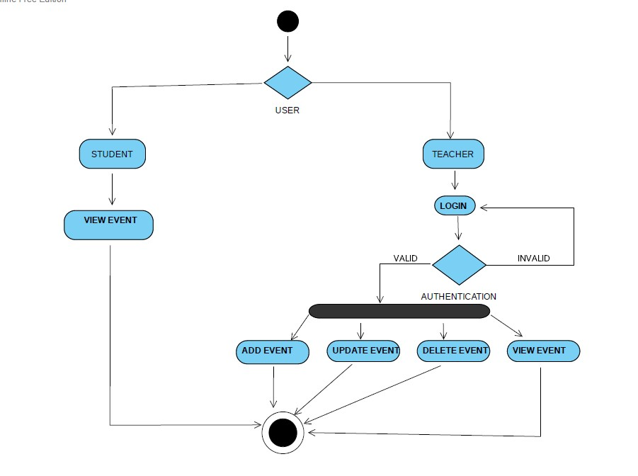
Activity diagram

Slide 13
